Slide 1
USDA Rural Development
Business Programs Overview – Nancy Pletcher Kansas City Food Hub – March 2021

Slide 2
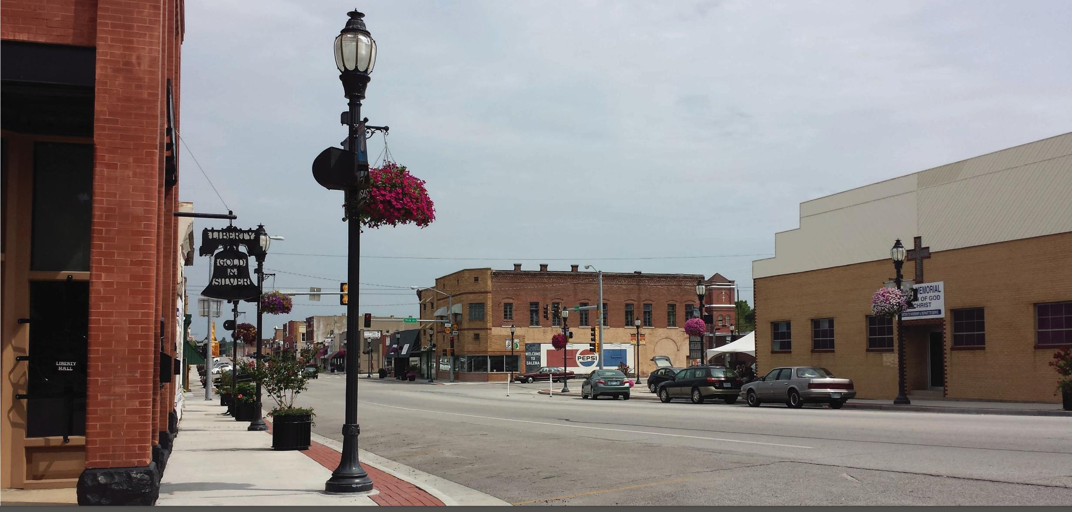
Committed to the Helping Improve the Economy and Quality of Life in Rural Kansas
Notes:
USDA Rural Development has a loan portfolio of more than $235 billion to bring enhanced economic opportunity to the Nation's rural communities.
In FY 2020 – USDA Rural Development invested $184 million into Rural Kansas communities.
Photos - Galena, KS – Sidewalk improvements

Slide 3

In 2020 USDA Rural Development Invested $184 million in Rural Kansas
52 rural Kansas business received a total of $15 million in financing
2,107 families or individuals received a total of $234 million in financing to buy or repair a home in rural Kansas
37 rural Kansas community projects received a total of $71 million in financing
20 rural Kansas communities received a total of $53 million in financing to improve water and sewer infrastructure

Slide 4
USDA Rural Business Programs
Rural Area
Business must be located in an eligible rural area
Ineligible areas are cities or towns that have a population of greater than 50,000 inhabitants and any urbanized area contiguous and adjacent to such city or town
Rural area determination tool: http://eligibility.sc.egov.usda.gov/eligibility/

Slide 5
Value-Added Producer Grant

Slide 6
Value-Added Producer Grant
Value-Added Producer Grants Details
Goals of the program are to generate new products, create and expand marketing opportunities, and increase income for the ag producer
Working capital grants up to $250,000
Planning grants up to $75,000
Requires a $1 producer match for each grant $1

Slide 7
Value-Added Producer Grant
VAPG utilization of Funds
Grant and matching funds cannot be used to build facilities, purchase land, produce the raw commodity or purchase equipment
Grant and matching funds can be used for planning activities, value-added processing costs, marketing and advertising expenses, distribution, and some inventory and salary expenses

Slide 8
Value-Added Producer Grant
VAPG Eligible Applicants
Independent producers
Farmer and rancher cooperatives,
Agricultural producer groups,
Majority controlled producer-based business ventures

Slide 9
Value-Added Producer Grant
VAPG Eligible Projects
Change in Physical State
Produced in a manner that enhances the value of the commodity
Physical Segregation
Farm or Ranch Based Renewable Energy
Aggregation and Marketing of Local Foods

Slide 10
Value-Added Producer Grant
Additional VAPG Eligibility Requirements
Applicant currently produces and owns at least 51% of the raw agriculture commodity needed for the project
Applicant maintains ownership of agriculture commodity from the raw state of production to the sale of the value-added product
Must demonstrate the applicant is entering an emerging market (new product sold for less than 2 years) or market expansion (existing product expanding customer base).

Slide 11
Value-Added Producer Grant
Feasibility Study and Business Plan
Working Capital applications greater than $50,000 do require a feasibility study and business plan.
An exception is that an applicant that qualifies as an independent producer that is expanding their market demonstrated by selling their product for 2 years can submit only a business plan.
Simplified applications less than $50,000 are not required to provide a feasibility study and business plan.
All applications, whether they require a feasibility study and business plan, are required to show the project is feasible.

Slide 12
Value-Added Producer Grant
Value-Added Producer Applications FY 2021
Funding Levels - $41 million comes from FY 2021 Appropriations and carryover from FY 2020
$35 million in COVID-19 relief funds which include a reduced cost share
match of 10 percent.
Deadlines – Paper applications must be postmarked by May 4, 2021
Applications are permitted through Grants.gov and received by 11:59 p.m.
April 29, 2021

Slide 13
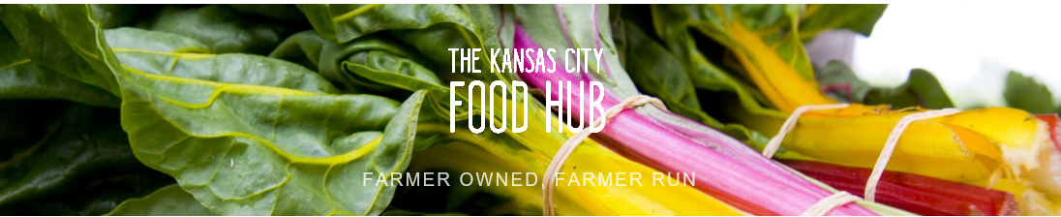
Value-Added Producer Grant
Kansas City Food Hub
Applied as a steering committee in 2015
Start up costs for developing a regional food hub.
Funds used to support staffing, software, legal support, accounting, consultants for market development
Notes:
Applied as Regional Food Hub Steering Committee. Before we signed grant agreement they legalized to Fresh Farm HQ Cooperative Association. Has developed into what is known today as the Kansas City Food Hub. Staff- Food hub coordinator, part-time CSA Coordinator, part-time bookkeeper. Almost $250,000 Federal. Match was in-kind time and produce match. I believe it started with 4 ag producers.

Slide 14
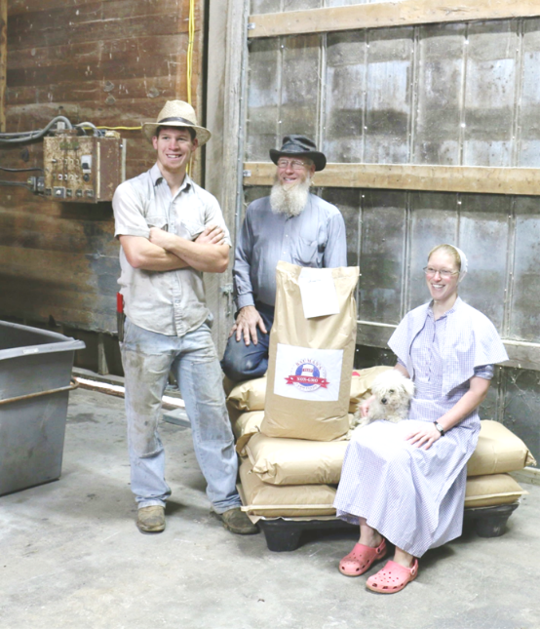
Value-Added Producer Grant
Bauman’s CVF
Garnett, Kan
Process non-GMO corn, soybeans and oats into GMO free livestock feeds
Funds used for packaging material and purchase of 3rd party corn and soybeans

Slide 15

Value-Added Producer Grant
Schenker Family Farm
McCune, Kan
Planning Grant for feasibility study regarding the establishment of a poultry processing facility
Working capital grant to expand their CSA to include meat entrees and meat based soups

Slide 16
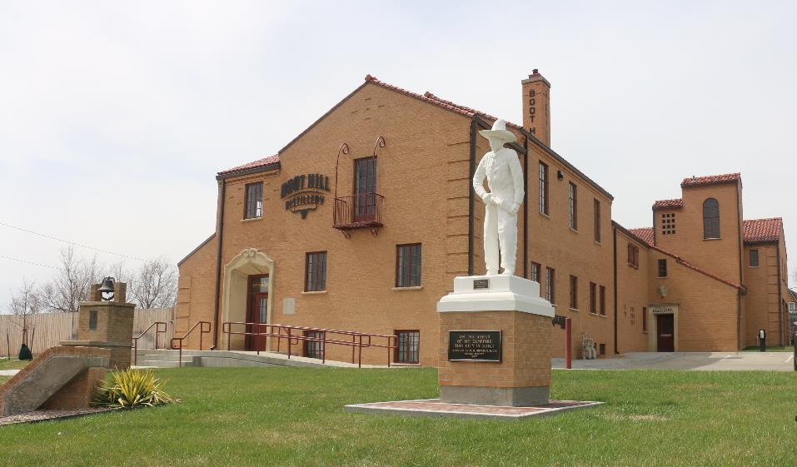
Value-Added Producer Grant
Boot Hill Distillery
Dodge City, Kan
Expand distribution to retail stores, brew pubs and restaurants in Kansas, Missouri, Colorado, Oklahoma and Nebraska
Funds for processing including labor, barrels, labels, bottles, additional ingredients, etc
Funds for advertising, marketing and traveling, as well as distribution

Slide 17
Rural Economic Development Loan

Slide 18
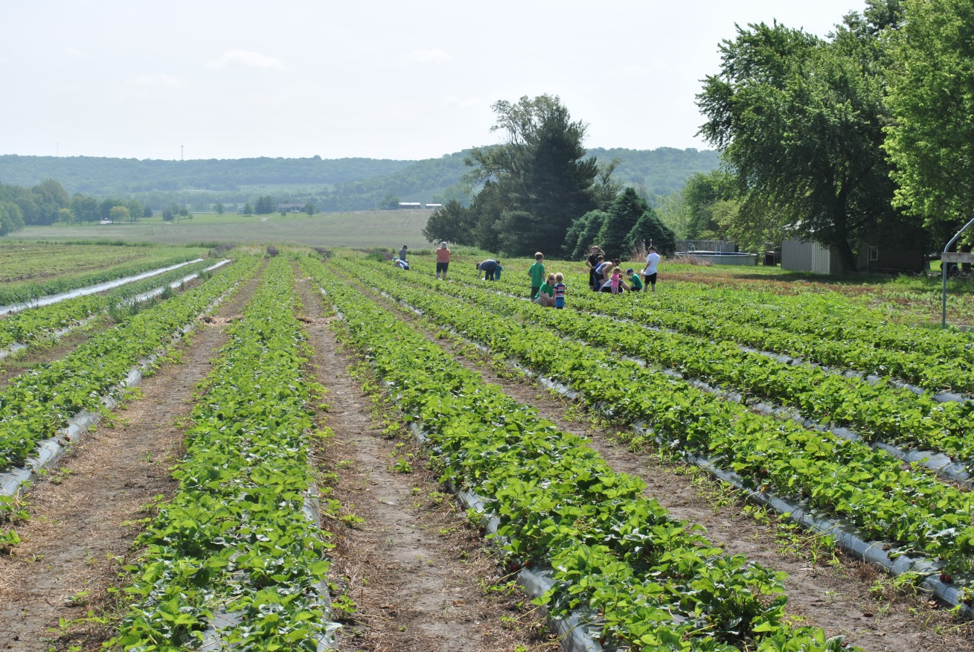
Rural Economic Development Loan (REDL) Program
Schwinn Produce Farms in Leavenworth, KS utilized a $81,000 Rural Economic Development Loan through Leavenworth-Jefferson Electric Cooperative (now FreeState) construct a building that will act as a retail store – farmers market.

Slide 19
Rural Economic Development Loan & Grant (REDLG) Program
REDLG Program Overview
Electric and telephone rural utility cooperatives are eligible to apply for REDLG
The loan/grant funds are then passed through to the ultimate recipients, which can be any legal entity, including individuals, public bodies, and federally recognized Indian Tribes

Slide 20
Business & Industry Guaranteed Loans

Slide 21
Business & Industry Guaranteed Loan
USDA’s guarantee enables lenders to serve borrowers who otherwise would be unable to get a loan
Program Purpose
Improve, develop, or finance business, industry, and employment
Improve the economic and environmental climate in rural communities
Provide lasting community benefits
Not intended for marginal or substandard loans

Slide 22
Business & Industry Guaranteed Loan
Eligible Business Entities
Profit Corporations &/or Non-Profit Corporation
Cooperatives
Partnerships
Indian Tribes
Individual Proprietors
Public Bodies

Slide 23
Business & Industry Guaranteed Loans
Loan Purposes
Real estate purchases and improvements
Machinery and equipment
Working capital
Debt refinancing
Local foods projects – Can also be done in urban areas

Slide 24
Business & Industry Guaranteed Loan
Agricultural Production Eligibility
Agricultural production is potentially eligible when not eligible for Farm Service Agency (FSA) farm loan programs assistance and when it is part of an integrated business also involved in the processing of agricultural products. Any agricultural production considered for guaranteed loan financing must be owned, operated, and maintained by the business receiving the guaranteed loan.
Examples of potentially eligible agricultural production include but are not limited to an apple orchard in conjunction with a food processing plant; poultry buildings linked to a meat processing operation; or sugar beet production coupled with storage and processing.
The agricultural production portion of any loan must not exceed 50% of the total loan or $5 million, whichever is less.

Slide 25
Business & Industry Guaranteed Loan
Other Potentially Eligible Agricultural Businesses
Commercial nurseries engaged in the production of ornamental plants, trees, and other nursery products, such as bulbs, flowers, shrubbery, flower and vegetable seeds, sod, and the growing of plants from seed to the transplant stage;
Forestry, which includes businesses primarily engaged in the operation of timber tracts, tree farms, forest nurseries, harvesting of forest products, and related activities, such as reforestation;
The growing or harvesting of mushrooms;
The growing of hydroponics;
The boarding and/or training of animals;
Commercial fishing; and
Production of algae and aquaculture, including conservation, development, and utilization of water for aquaculture.

Slide 26
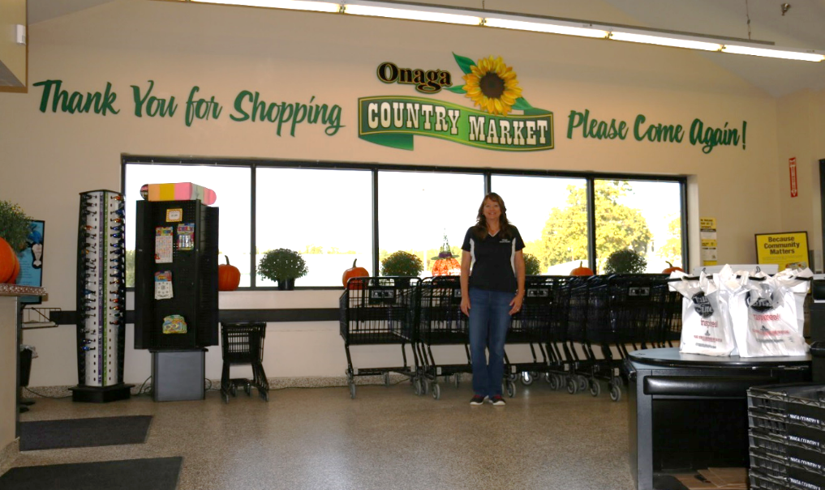
Business & Industry Guaranteed Loans
Onaga Country Market
$500,000 USDA Business & Industry Guaranteed Loan
Purchase equipment needed to construct and operate a new grocery store in Onaga
Multiple funding partners came together to make this project happen including: Network Kansas, City of Onaga, Pottawatomie County

Slide 27
Rural Energy for America Program

Slide 28
Rural Energy for America Program (REAP)
REAP Program Overview
Provides guaranteed loan financing and grant funding to agricultural producers and rural small businesses for renewable energy systems or to make energy efficiency improvements
Grants and Guaranteed Loans
Renewable energy development
Energy efficiency improvements and renewable energy systems

Slide 29
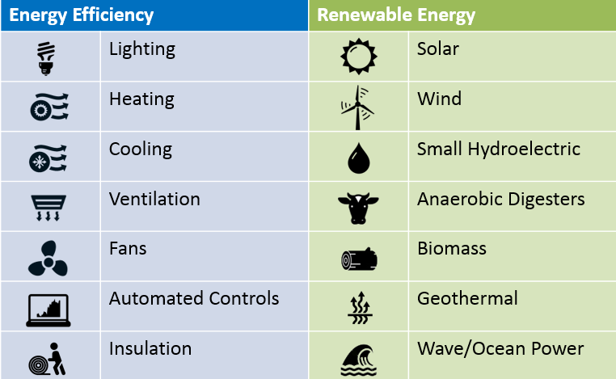
Rural Energy for America Program
The next review of REAP applications will be March 31, 2021

Slide 30
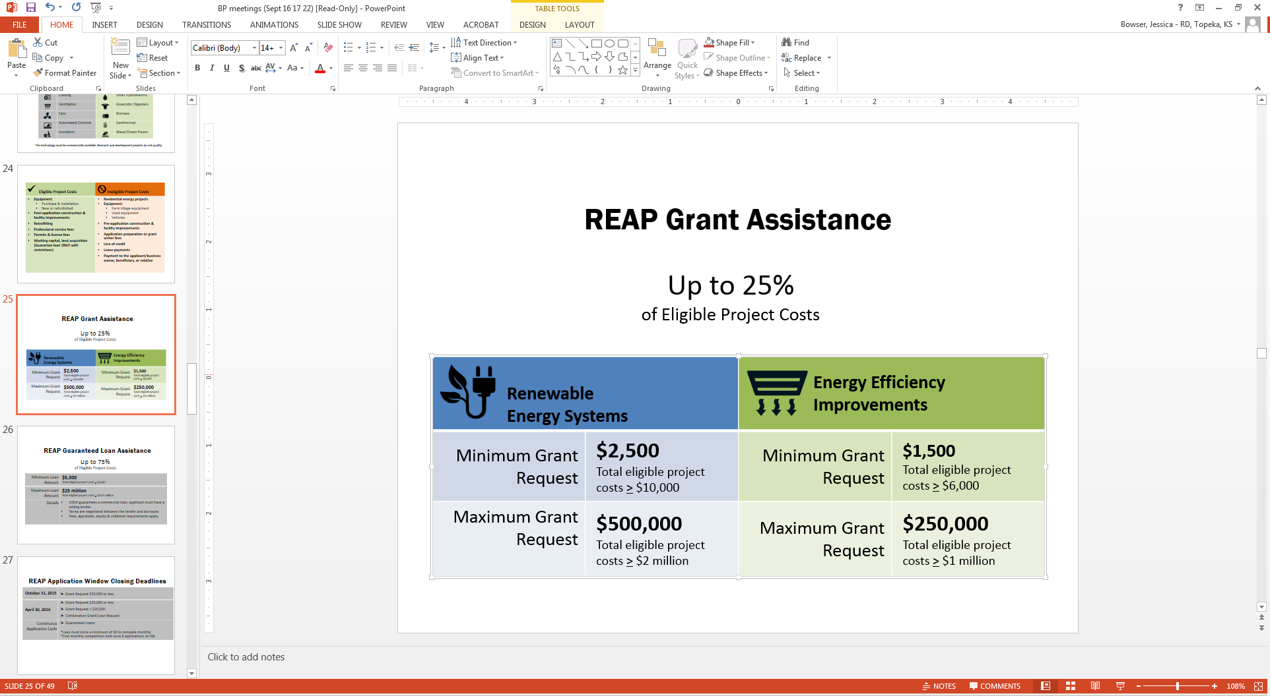
Rural Energy for America Program
REAP Grants
Up to 25% of Eligible Project Cost

Slide 31
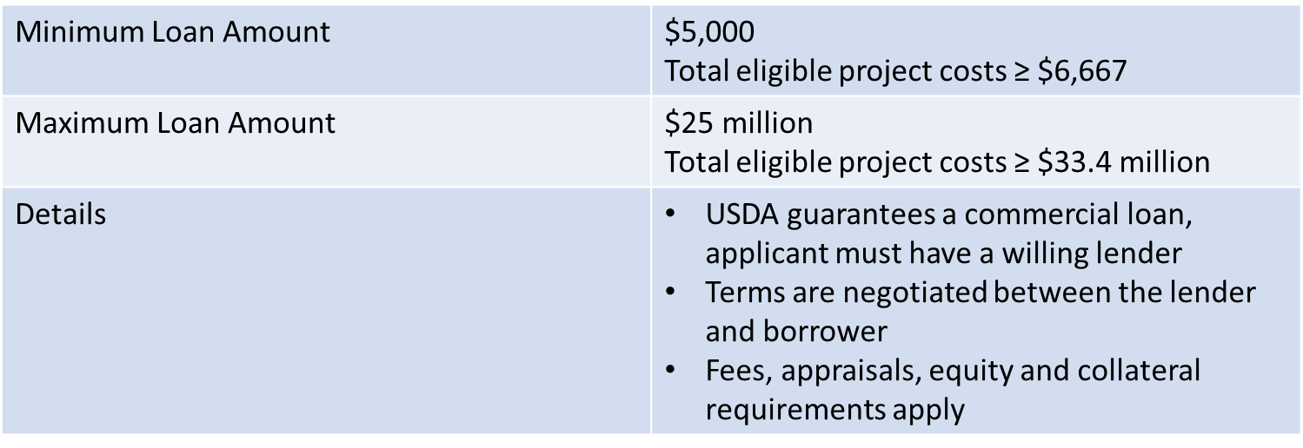
Rural Energy for America Program
REAP Guaranteed Loans
Up to 75% of Eligible Project Costs

Slide 32
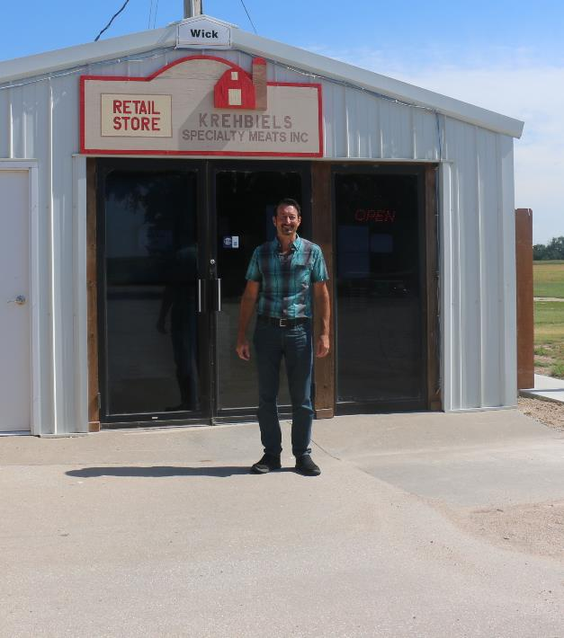
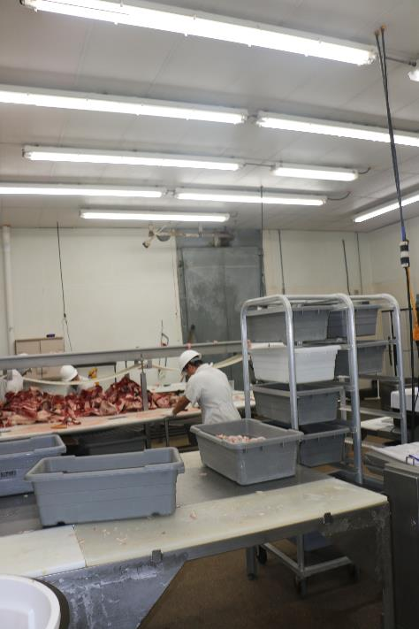
Rural Energy for America Program
Krehbiels Specialty Meats, Inc.
McPherson, KS
Replaced existing lighting with energy efficient LED lighting in the retail store and processing plant
Energy savings approximately $9,500 per year, 2.53 year simple payback
Total project cost $24,285, received a $6,071 REAP grant

Slide 33
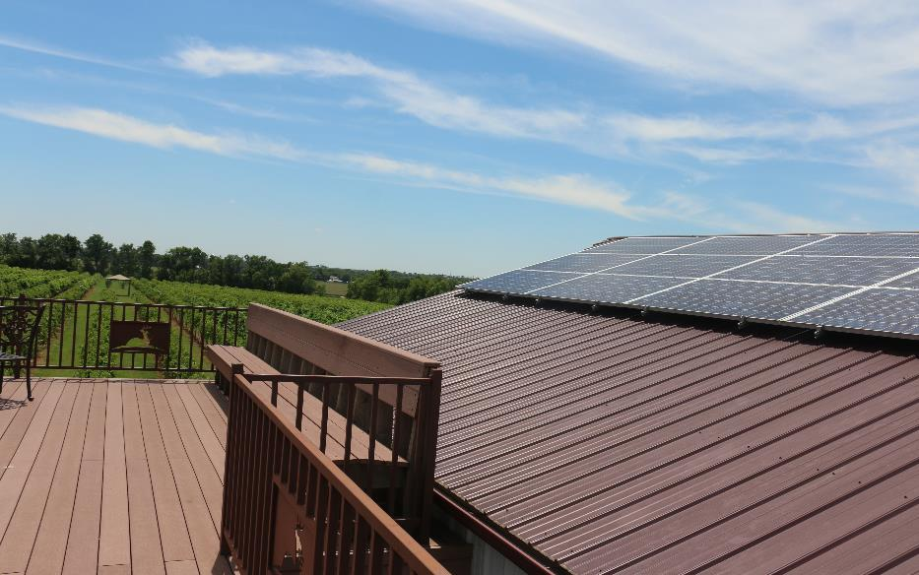
Rural Energy for America Program
Sollo Vineyard
Whitewater, Kan.
$20,000 REAP grant to purchase and install a 53 kilowatt solar array
The solar energy created will replace 80% of the business’ energy use per year

Slide 34
USDA Business Programs Staff
David Kramer Business Programs Director Topeka State Office (785) 271-2736 david.kramer@usda.gov
Nancy Pletcher Business Programs Specialist Topeka State Office (785) 271-2733 nancy.pletcher@usda.gov | Jennifer Yarbrough Business Program Specialist Topeka State Office (785) 271-2727 jennifer.yarbrough@usda.gov | Doug Bruggeman Business Programs Specialist Hays Area Office (785) 628-3081 doug.bruggeman@usda.gov | Travis Snider Business Programs Specialist Newton Area Office (316) 282-3477 travis.snider@usda.gov | William Fritz Business Programs Specialist Iola Area Office (620) 380-3112 William.fritz@usda.gov

Slide 35
Find More Information at: www.rd.usda.gov/ks
Follow us at: @Rur_DevKansas

