Slide 1

Welcome!
Please mute your mics
AND
Add your name and organization to the chat

Slide 2
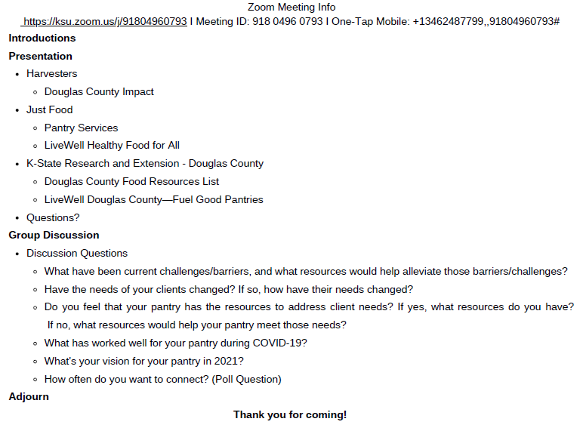

Slide 3

County-Wide Pantry Meeting
By: Cheryl Barnes and Cierra Smallwood

Slide 4
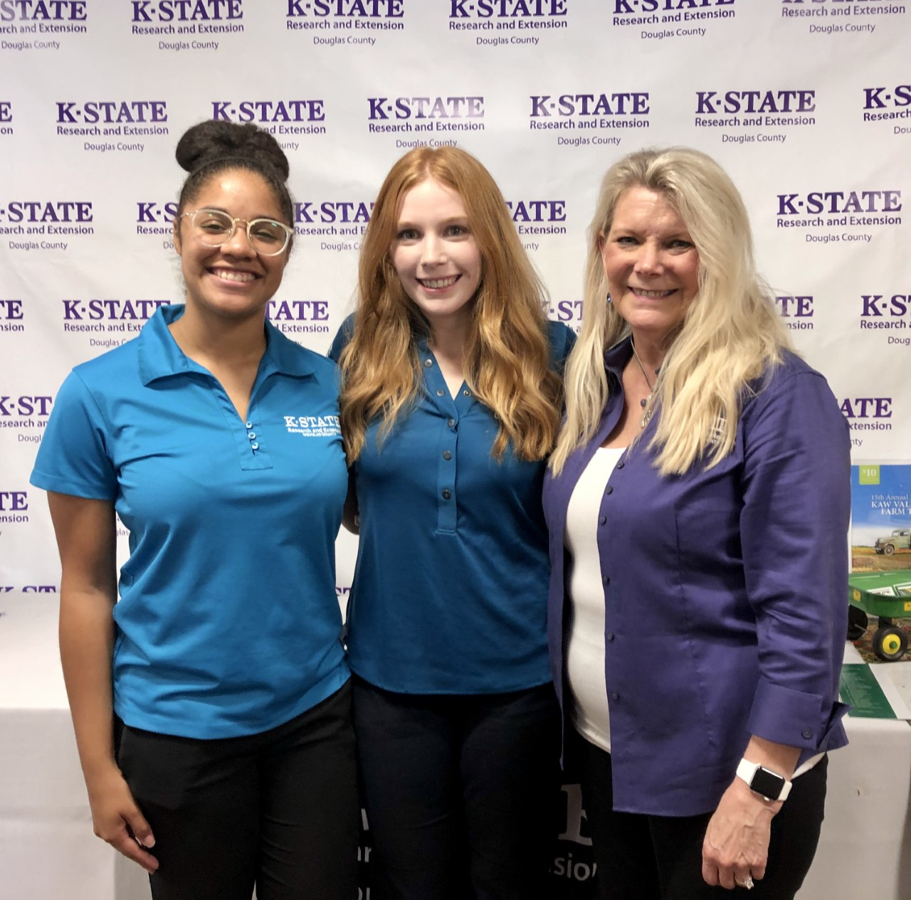
What is SNAP-Ed?
SNAP-Ed supports low-income Kansans in making the healthy choice the easy choice
We teach nutrition classes to youth, adults, families, and older adults.
Class Topics:
Easy meal planning according to MyPlate
Stretching limited food dollars
Increasing physical activity
Improving skills for safe food handling and preparation
Visit https://www.hhs.k-state.edu/ks-snaped/free-classes.html for upcoming SNAP-Ed classes
We implement Policy, Systems, and Environmental Changes (PSE) to support health behaviors

Slide 5

Douglas County Food Resources List
List of food resources in Douglas County to access
Google Doc that is ongoing and updated frequently
Featured food resources
Government Assistance
Food Pantries
Mobile Food Distribution Sites
Community Meals
General, youth, and seniors

Slide 6
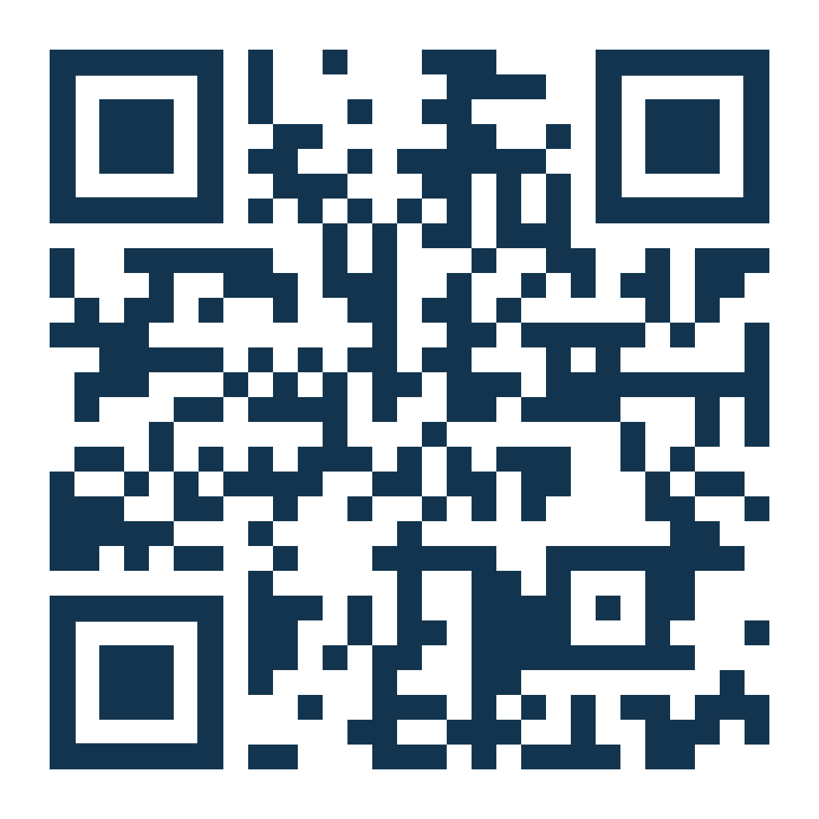
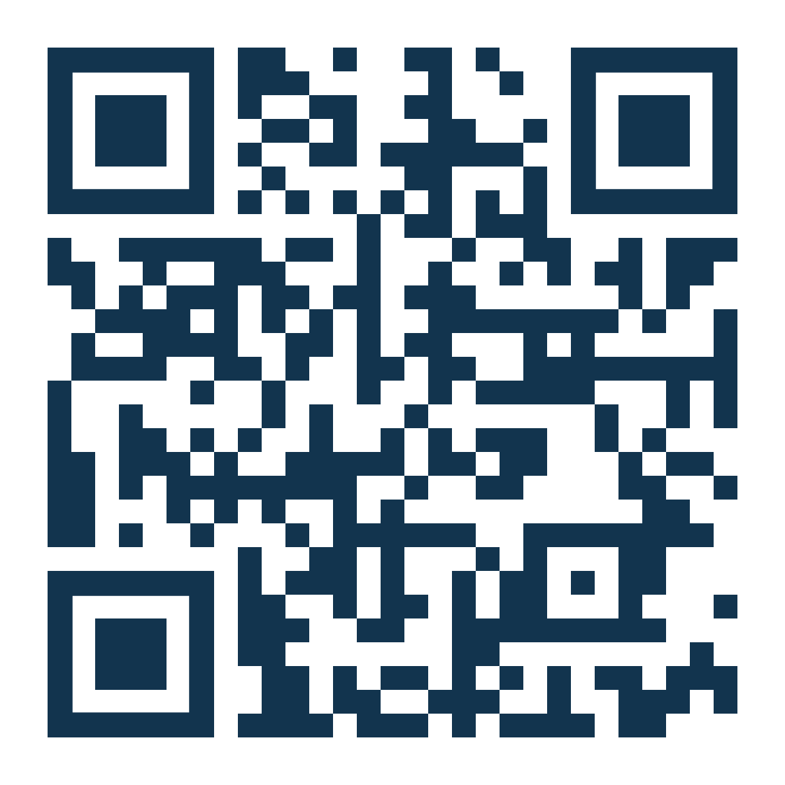
Douglas County Food Resource List
English Food Resource List
Link: https://tinyurl.com/ycsbso5h
Spanish Food Resource List
Link: https://tinyurl.com/ycmfty3e

Slide 7

Fuel Good Pantries
LiveWell Douglas County

Slide 8
Fuel Good Pantry Overview
Mission
Contribute to increased access and consumption of healthy food, nutrition education, and health resources available to food assistance program clientele in Douglas County.
Program Goals
Incorporation of fuel good standards as a food purchasing and collecting practice.
Assist more food-insecure people by increasing SNAP enrollment opportunities.
Provide increased education about healthy foods and activities, including benefits, choices, production, and preparation.

Slide 9
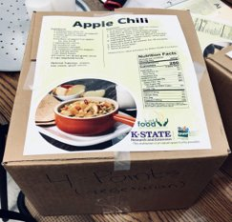
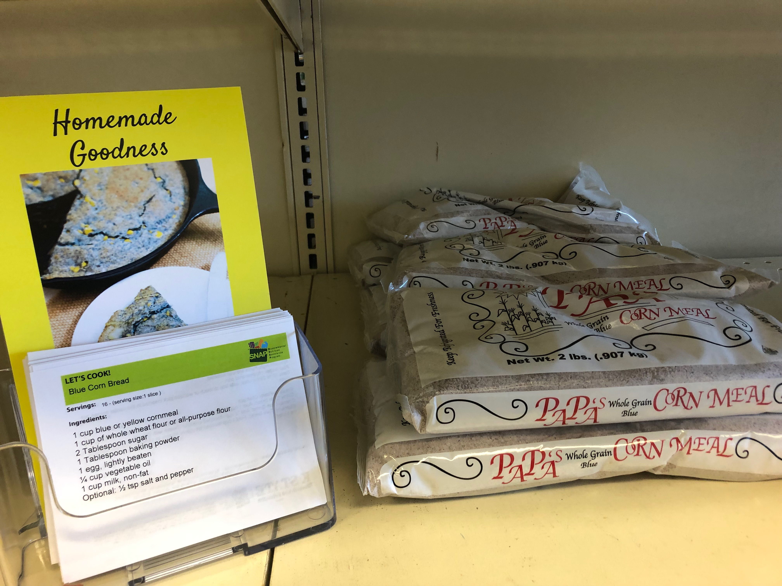
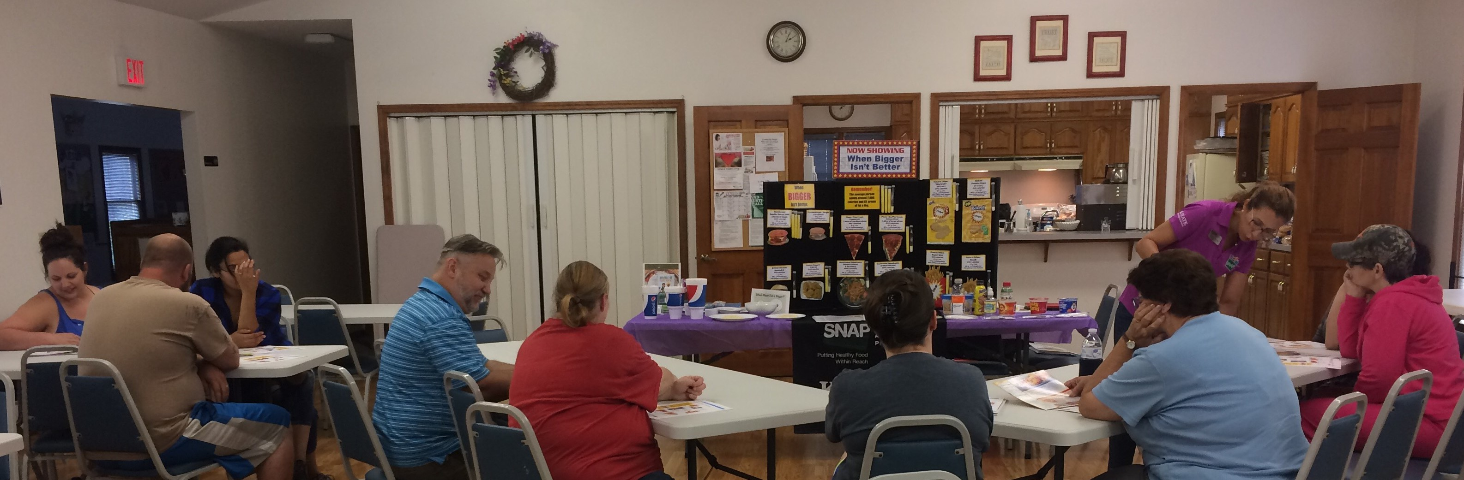
Fuel Good Activity Examples

Slide 10
Becoming a Partner

Slide 11
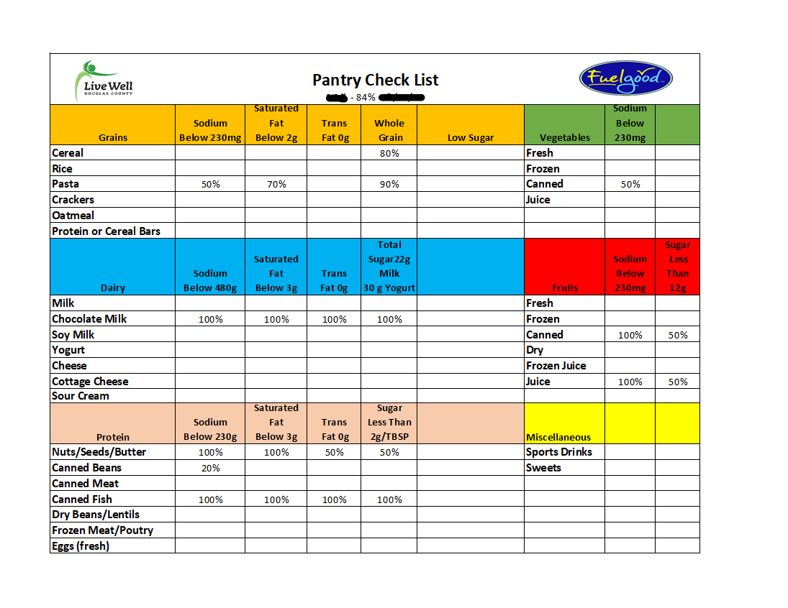
Meet with a pantry advocate to complete the Fuel Good Pantry Checklist

Slide 12
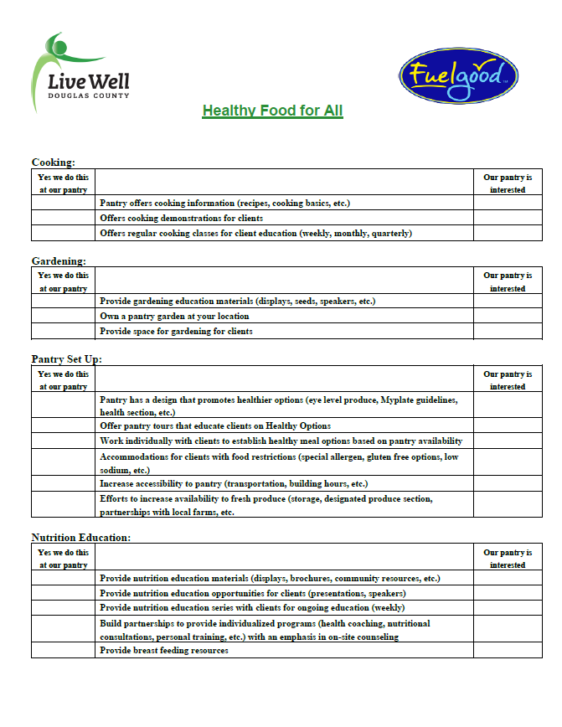
Choose a unique plan of action for your pantry

Slide 13

Select LiveWell partners who are ready to assist you in achieving your healthy pantry goals

Slide 14
Complete the Fuel Good Pantry Checklist annually

Slide 15


Questions?
Cierra Smallwood: cierras@ksu.edu
Cheryl Barnes: cheryl47@ksu.edu
Susan Farley: susanfarley@ksu.edu
Office #: 785-843-7058
Kansas State University Agricultural Experiment Station and Cooperative Extension Service
K-State Research and Extension is an equal opportunity provider and employer.

Slide 16
